Slide 1
Genome Evolution and Selfish Genetic Elements (SGEs). Lectures 5 and 6.
Learning objectives:
Understand the C-value paradox and the organization of typical eukaryotic (especially) vertebrate genome
Understand how genomes evolve and how different mechanisms contribute to a change in genome size
Understand the classification and modes of mobility of SGEs
Understand how SGEs interact with/impact genome evolution

Slide 2
The C-value paradox
The C-value is defined as the amount (bp) of DNA in a haploid genome. e.g. the human genome has around 3.2 billion bp per haploid genome (even though we are of course diploid).
But, some ‘simpler’ organisms have larger C-values than much more ‘complex’ organisms. i.e. gene number does not always correlate with genome size. This is one aspect of the paradox.
i.e. we would expect to see a linear relationship between complexity (e.g. gene number) and C-value

Slide 3
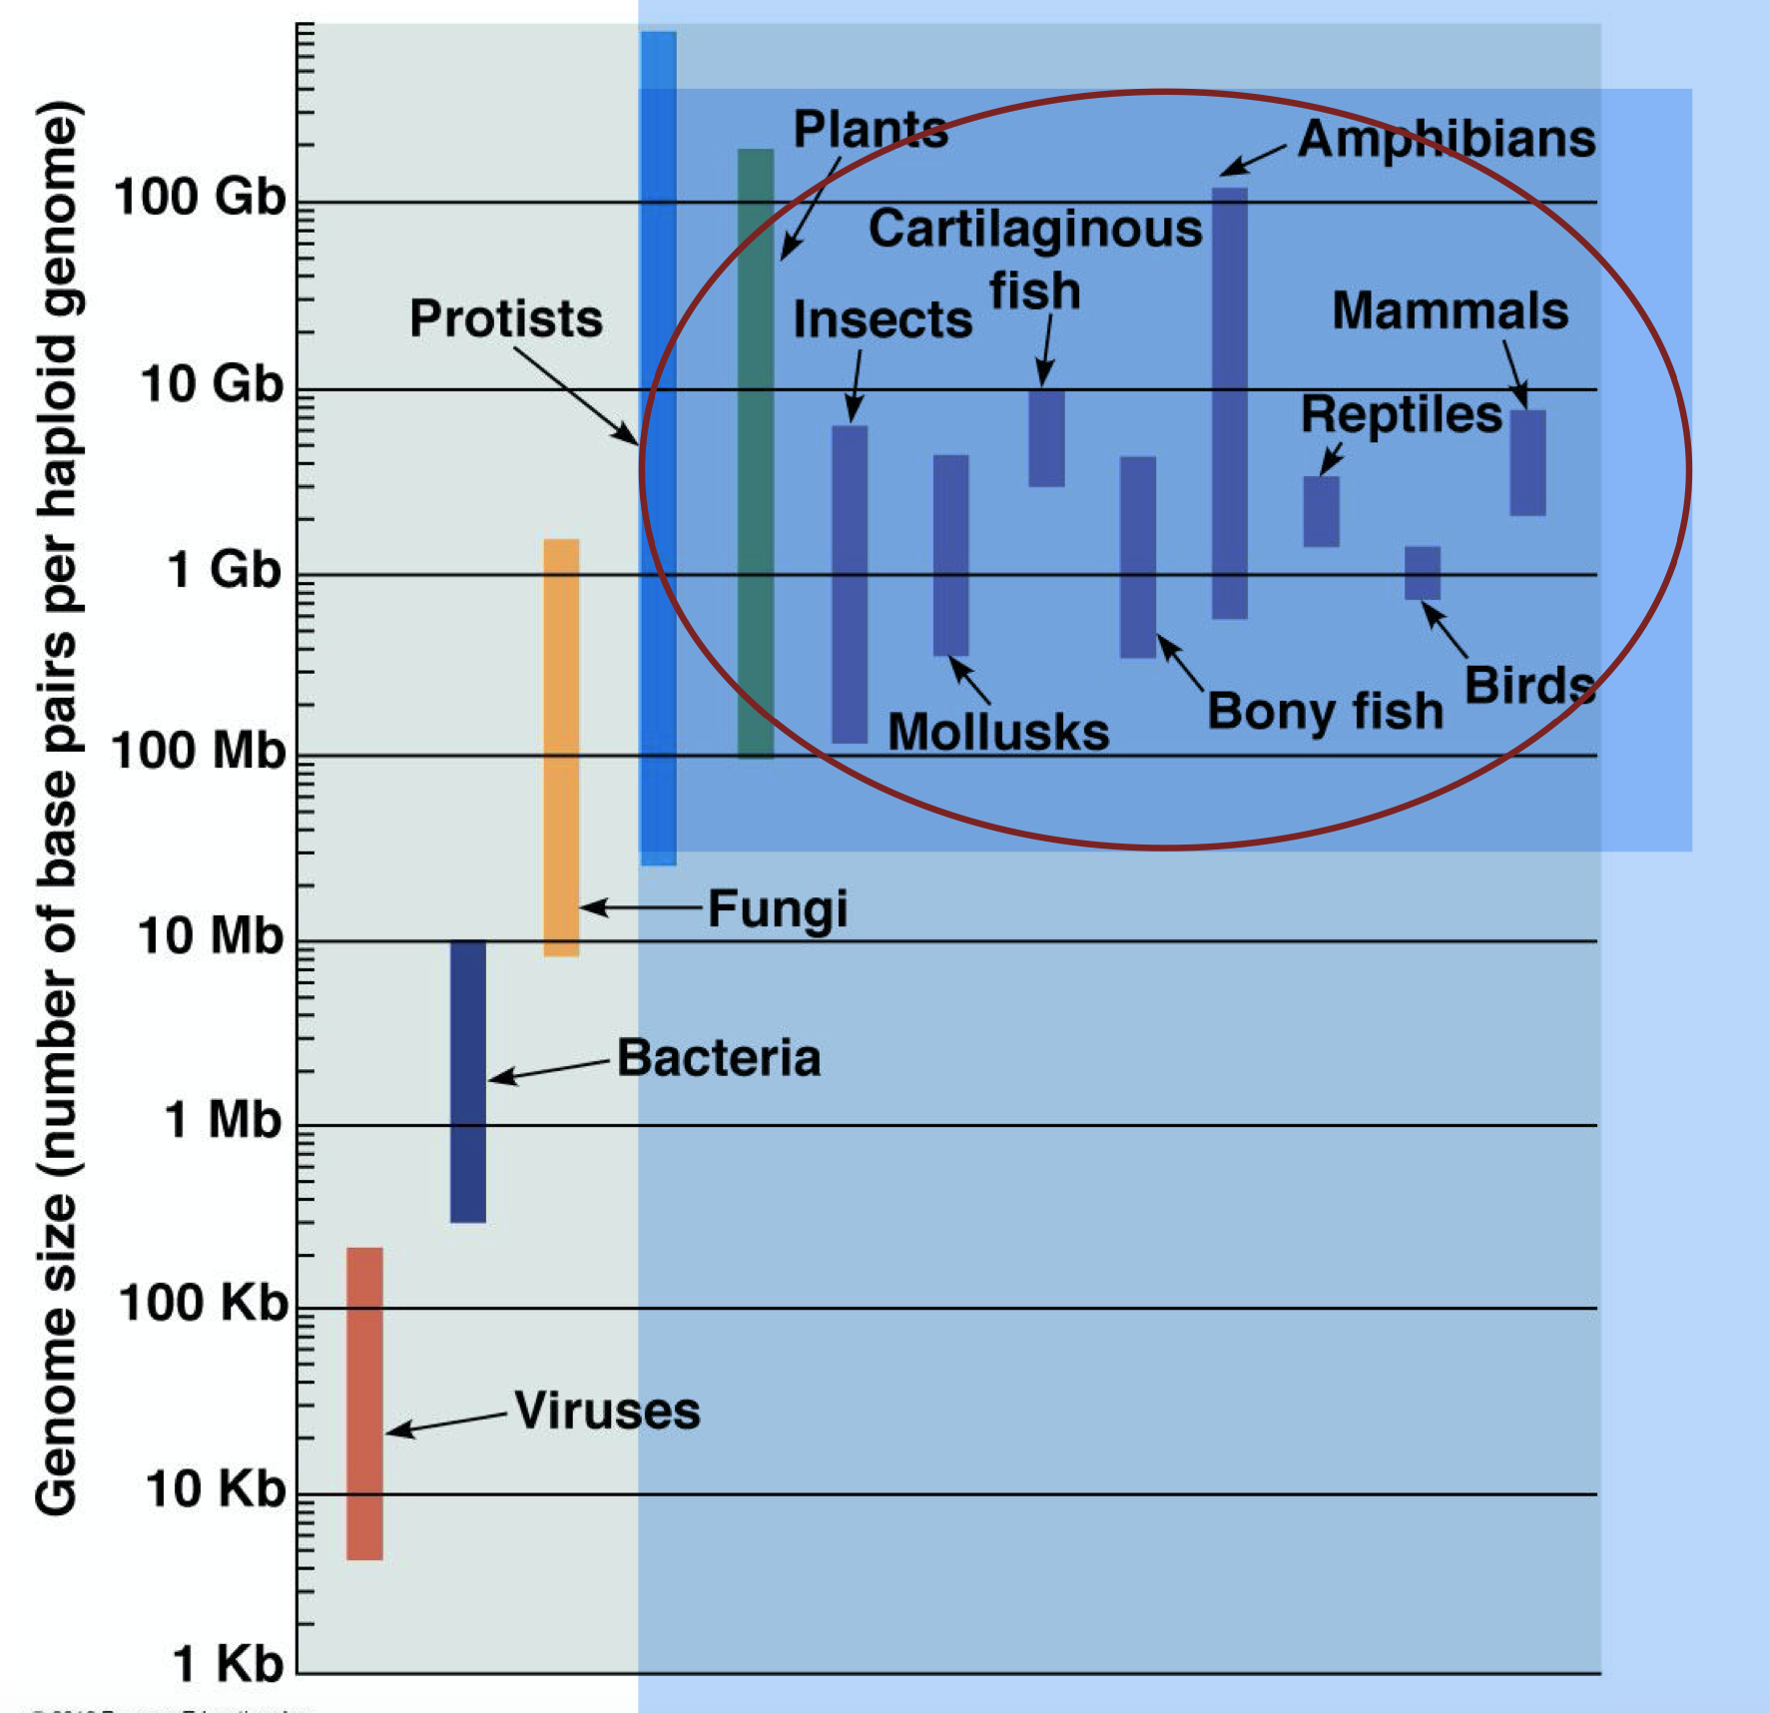
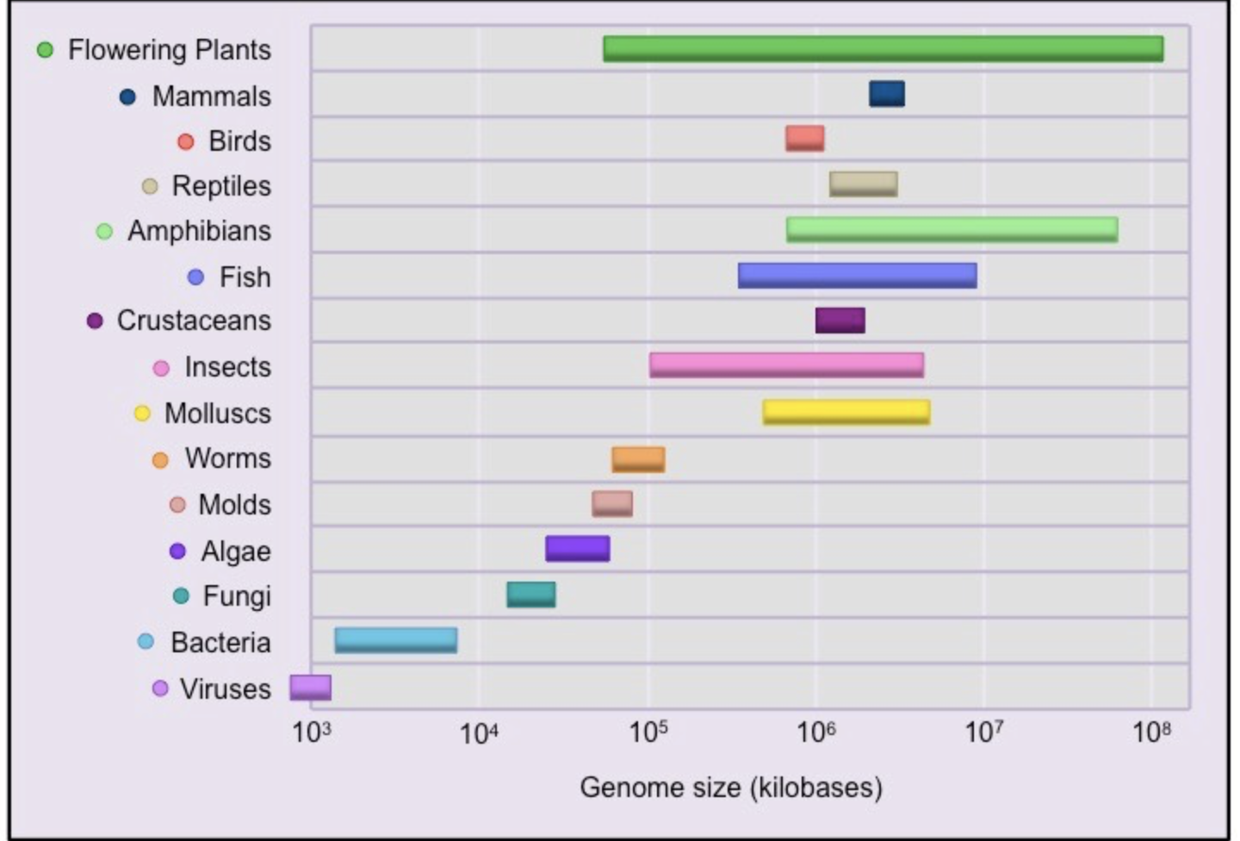
C-values of various organisms
There is also more variation in genome size within certain taxonomic groups when compared to others. e.g. compare flowering plants and amphibians to humans.
Thus some ’simple’ protists have a larger genome size than some more ‘complex’ vertebrates including humans

Slide 4
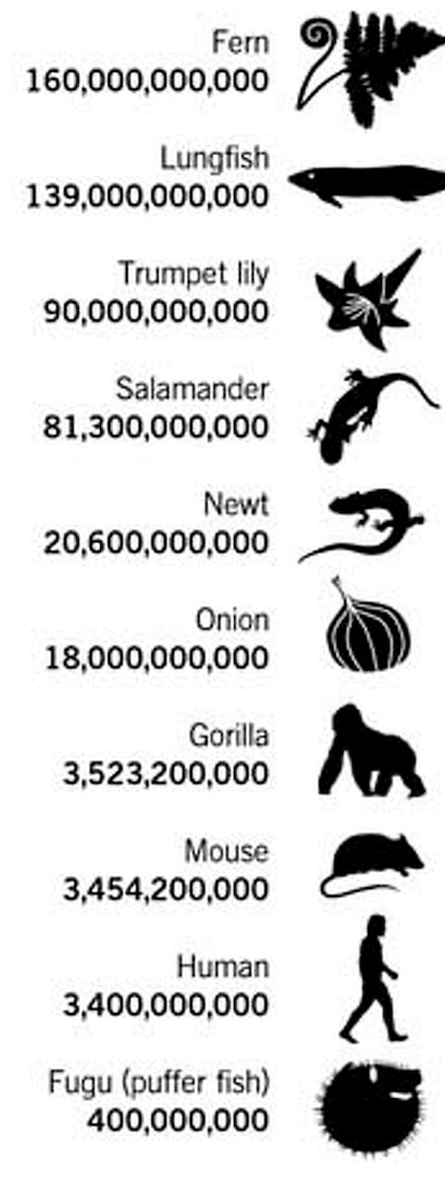
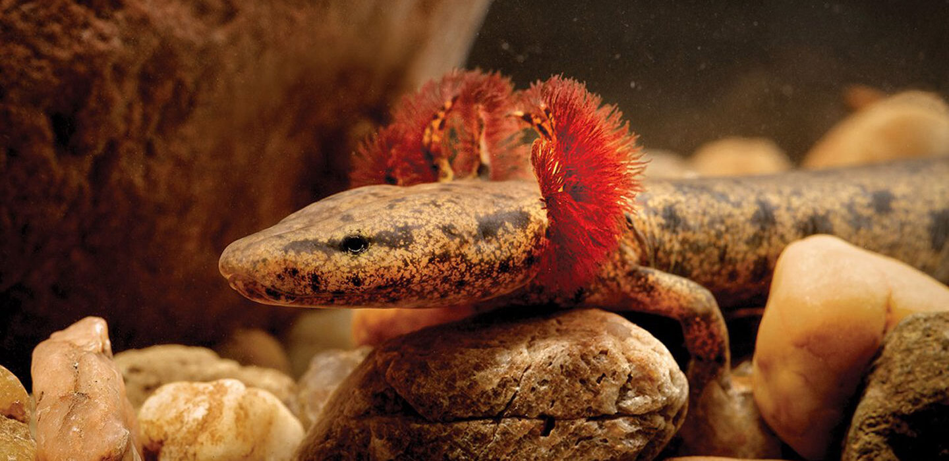
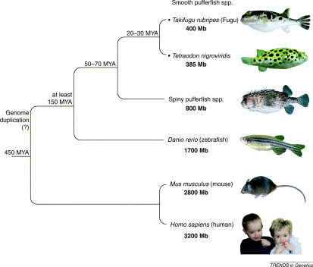
The paradox….
To very large- the waterdog (a species of salamander) has a genome 38 times the size of a human!
From very small genomes compared to humans (Fugu… 1/10 human genome size)
Notes:
https://www.scientificamerican.com/article/junk-dna-deforms-salamander-bodies/

Slide 5
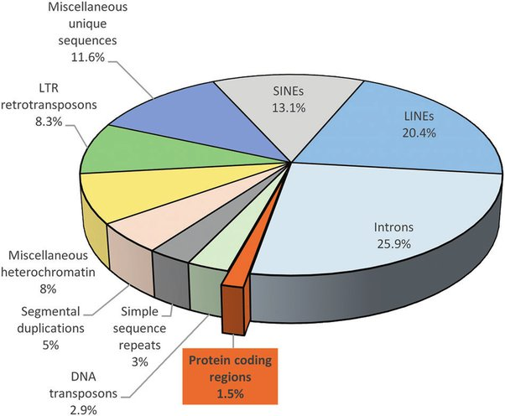
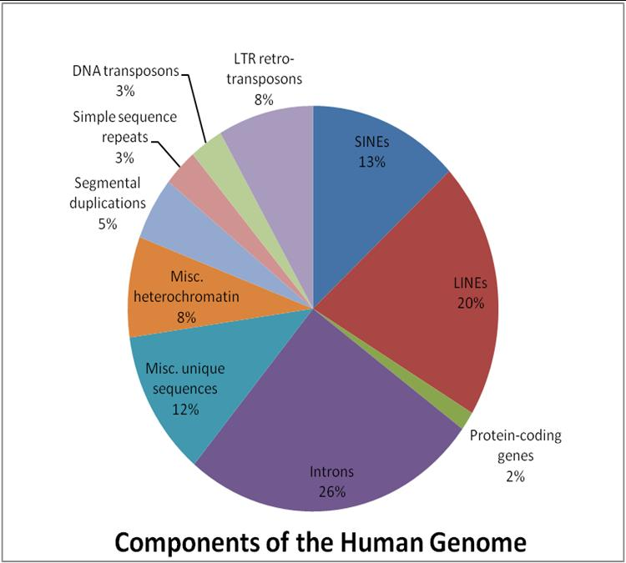
Explaining the paradox
Although quite complex, one of the contributing explanations is the variation in the amount of non-coding DNA (non-genic DNA) in an organism-in the cases in the previous slide this is at least partly due to the numbers of SGEs (later in lecture)
Non-genic DNA varies hugely, between even closely related orgainisms.

Slide 6
Changes in genome size are due to:
Ancestral changes in genome size-genome duplication with polyploidy
Ancestral and ‘ongoing’ changes in genome size:
(i) hybridization with allopolyploidy
(ii) chromosome duplication, fusion, inversions and segmental duplications
(iii) transposition of SGEs (later in lecture)
(iv) new genes (lectures 1 and 2)
(v) unequal crossover in repetitive DNA
(vi) replication slippage

Slide 7
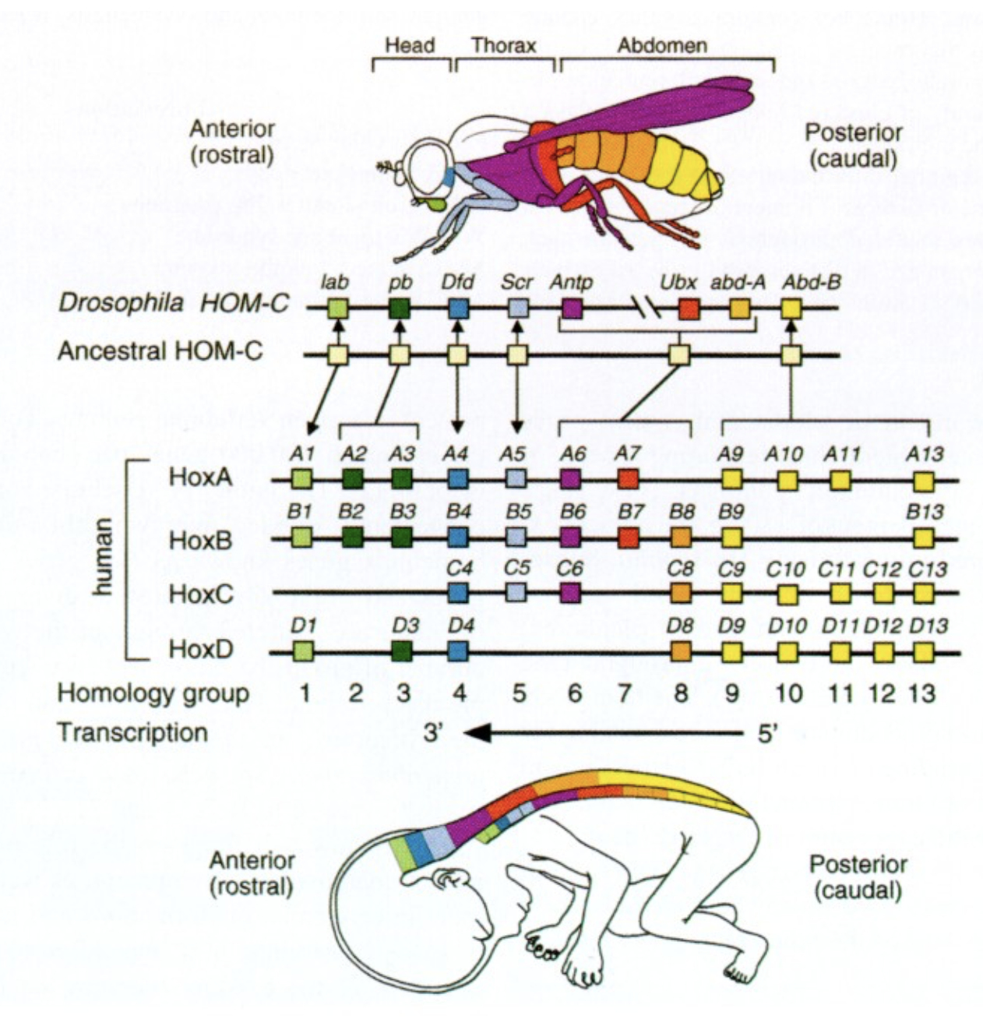
Ancestral changes in genome size
There were two complete genome duplications early in the evolution of vertebrates
One of the major pieces of evidence for this is the evolution of the hox genes. Hox genes control vertebrate development
The are four dispersed clusters of hox genes in humans but only one in flies
Ignore the names but do you note anything in common between the four clusters?
Notes:
Genomic organization and colinear expression patterns of Drosophila HOM genes and mammalian Hox genes. Schematic representation of the Drosophila homeotic complex (HOM-C), the four human Hox complexes and a hypothetical ancestral homeotic complex are displayed showing their possible phylogenic relationships[modified from Favier and Dollé⁽¹³⁾]. Each gene is represented by a colored box. The expression domains of HOM/Hox genes are schematized in a fly and in the CNS and prevertebrae of a human fetus (extrapolated from data in the mouse). For the sake of clarity, the partial overlap between HOM gene transcripts in thoracic and abdominal segments of the fly and overlapping expression domains of mammalian Hox genes along the body axis are not represented; hence, each color is meant to show the anteriormost expression domain of a given subfamily. HOM gene abbreviations are: lab, labial; pb, proboscipedia; Dfd, Deformed; Scr, Sex combs reduced; Antp, Antennapedia; Ubx, Ultrabithorax; abd-A, abdominal-A; Abd-B, Abdominal-B.
https://www.nature.com/articles/pr19972506

Slide 8
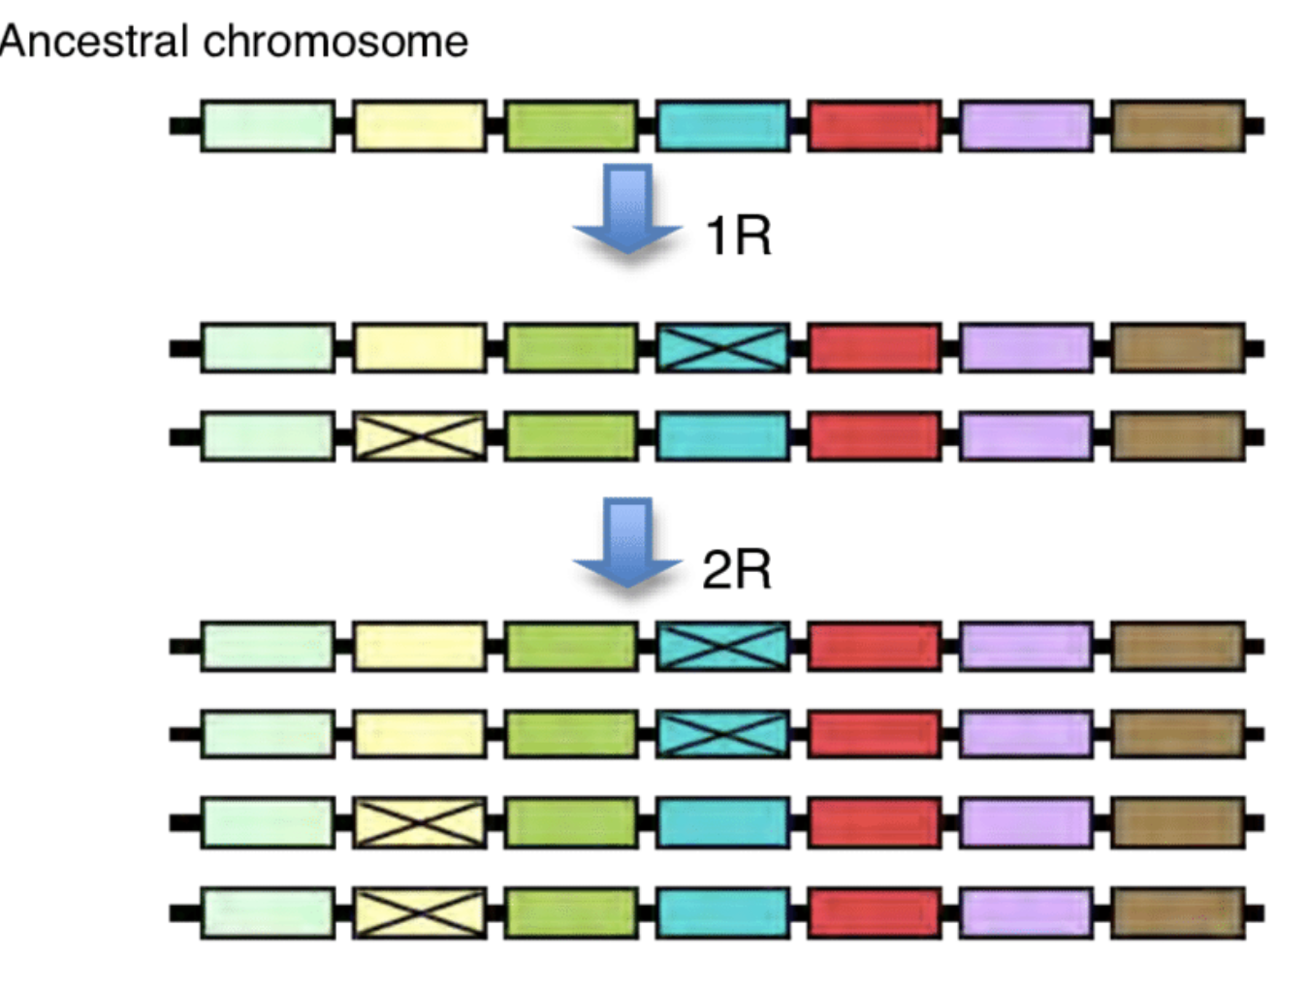
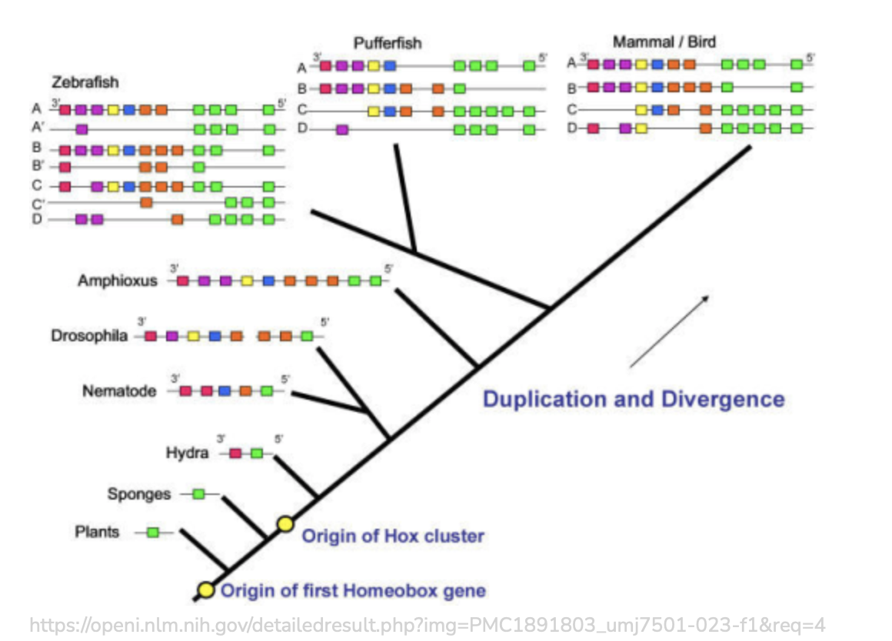
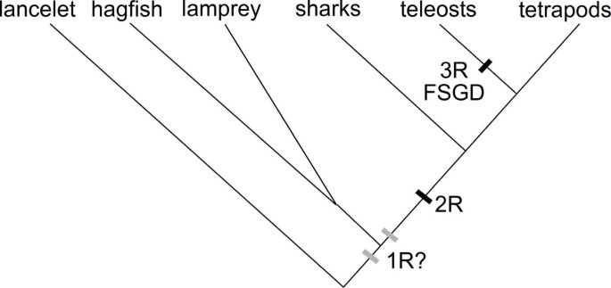
Similarities in the order of the genes between the clusters suggest they underwent two rounds of duplication. Some genes have decayed/been lost since then.
This and evidence from other gene families suggest the whole genome was duplicated at least twice in the past and has been further duplicated in other vertebrate taxa since
e.g. Zebrafish and relatives have undergone another round of genome duplication
Notes:
The first two whole genome duplication events pictured by a single chromosome duplicating. Crossed over boxes represent gene duplicate losses and blue arrows indicate whole genome duplication events. Illustration by David Lagman. Whole genome duplications is today most common in plants where many species is polyploid i.e. have several copies of each chromosome (Van de Peer et al. 2009). In vertebrates, however, it is not as clear due to that most of today's vertebrates are diploid i.e. have two copies of each chromosome (Van de Peer et al. 2009) often the result of a regression towards a diploid state after duplication. This is believed to happen because diversification of gene copies and their chromsomes over time makes them less similar to the other in the pair (Wolfe 2001). Examples of extant tetraploid vertebrates are the African clawed frog Xenopus laevis and common carp Cyprinus carpio (Larhammar and Risinger 1994).

Slide 9
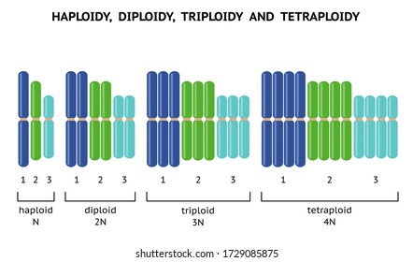
Polyploidy-via genome duplication
Flies and humans are diploid, but some other vertebrates are triploid, tetraploid or even octoploid…(some fish species)
The duplication events early in vertebrate evolution suggest that early vertebrates were tetraploid, at least for short periods. Reversion to diploidy likely occurred via divergence between chromosome pairs

Slide 10
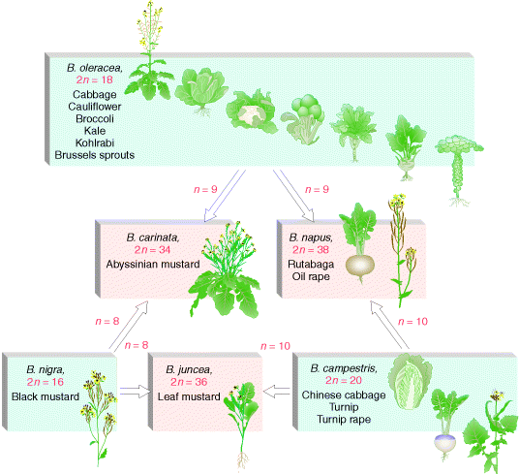
Allopolyploidy via hybridization
Two closely related species can hybridize with each other, leading to an effective doubling of genome size. This occurs most often in plants

Slide 11
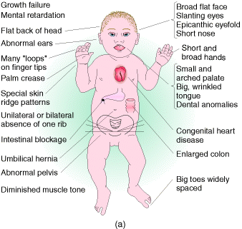
Chromosomal (i) duplications, (ii) loss, (iii) splitting/fusion and (iv) inversions/segmental duplications
Aneuploidy (abnormal chromosome number) via gain ((i) trisomy) or loss ((ii) monosomy) of a whole chromosome also occurs but is quite rare due to damaging gene dosage effects.
e.g. Downs syndrome, caused by an extra copy (trisomy) of
chromosome 21
Notes:
Trisomy 13 (Patau syndrome) and trisomy 18 (Edwards syndrome) are the other two well known human trisomies (both survive less than a few years)

Slide 12
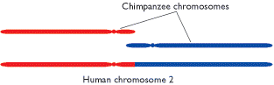
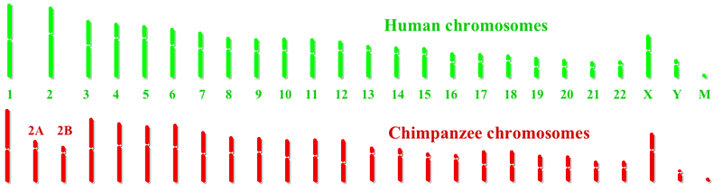
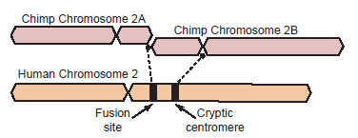
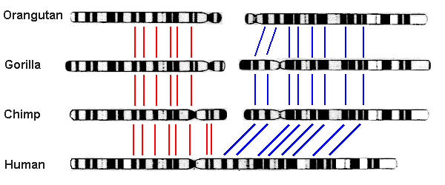
Chromosomal (iii) splitting/fusion
A well-known example is the fusion of two chromosomes in the hominid lineage since our divergence from chimpanzees
This occurred in the human lineage rather than the chimpanzee lineage
The remains of a telomere are present on human chromosome 2

Slide 13
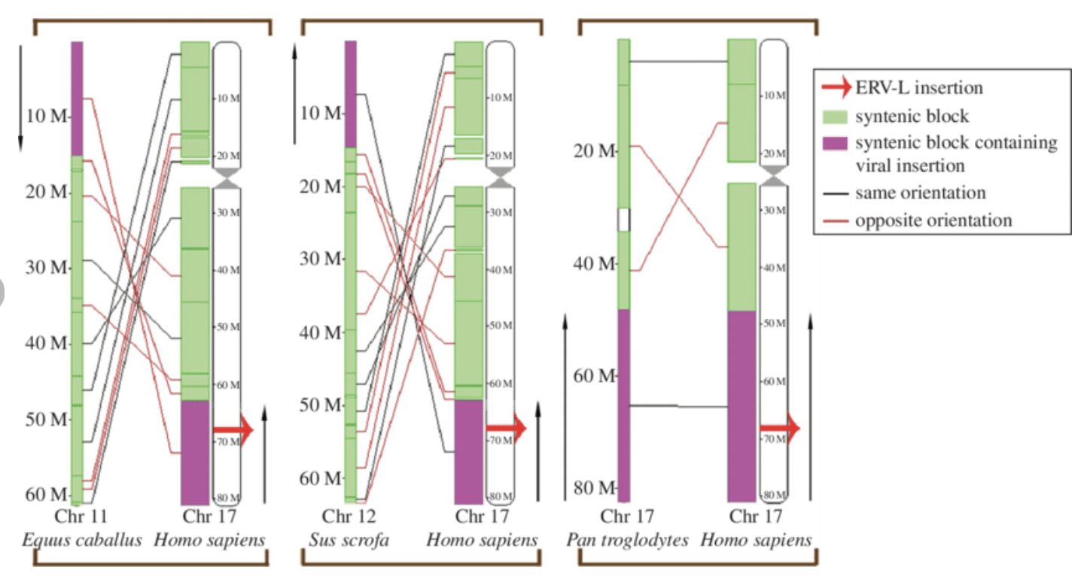
Chromosomal (iii) inversion/segmental duplications
Large scale inversions ‘scrambling’ of chromosomes occur over time. This is from one of my papers introducing a selfish genetic element
Synteny=regions where chromosomal segments map between species. Lines represent movement/inversion of syntenic blocks
ERV.L insertion=oldest virus ever identified

Slide 14
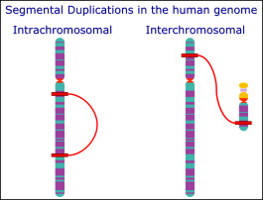
Chromosomal (iii) inversion/segmental duplications
Approximately 5% of the human genome consists of segmental duplications (regions of duplicated DNA within or between chromosomes). Some are more than 100,000bp in size and have occurred recently in humans

Slide 15
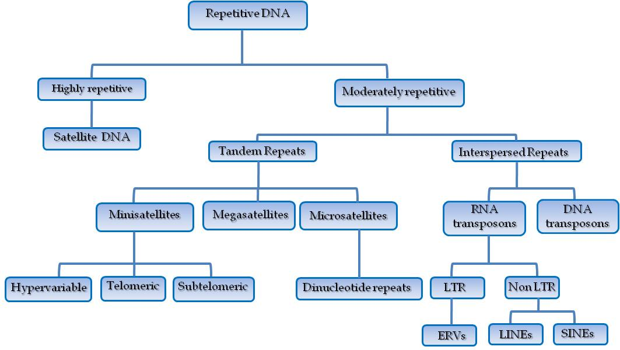
Genomic repetitive DNA
Repeat regions are subject to rapid rates of expansion or deletion, hence promoting relatively rapid changes in genome size between organisms . The more repetitive the region the more frequently change occurs
Classification of repetitive DNA is complex so I will just outline a few examples now and will discuss RNA and DNA transposons later
Notes:
Satellite DNA is present in centromeres and heterochromatic (covered in the practical). Microsatellites are used in DNA fingerprinting

Slide 16
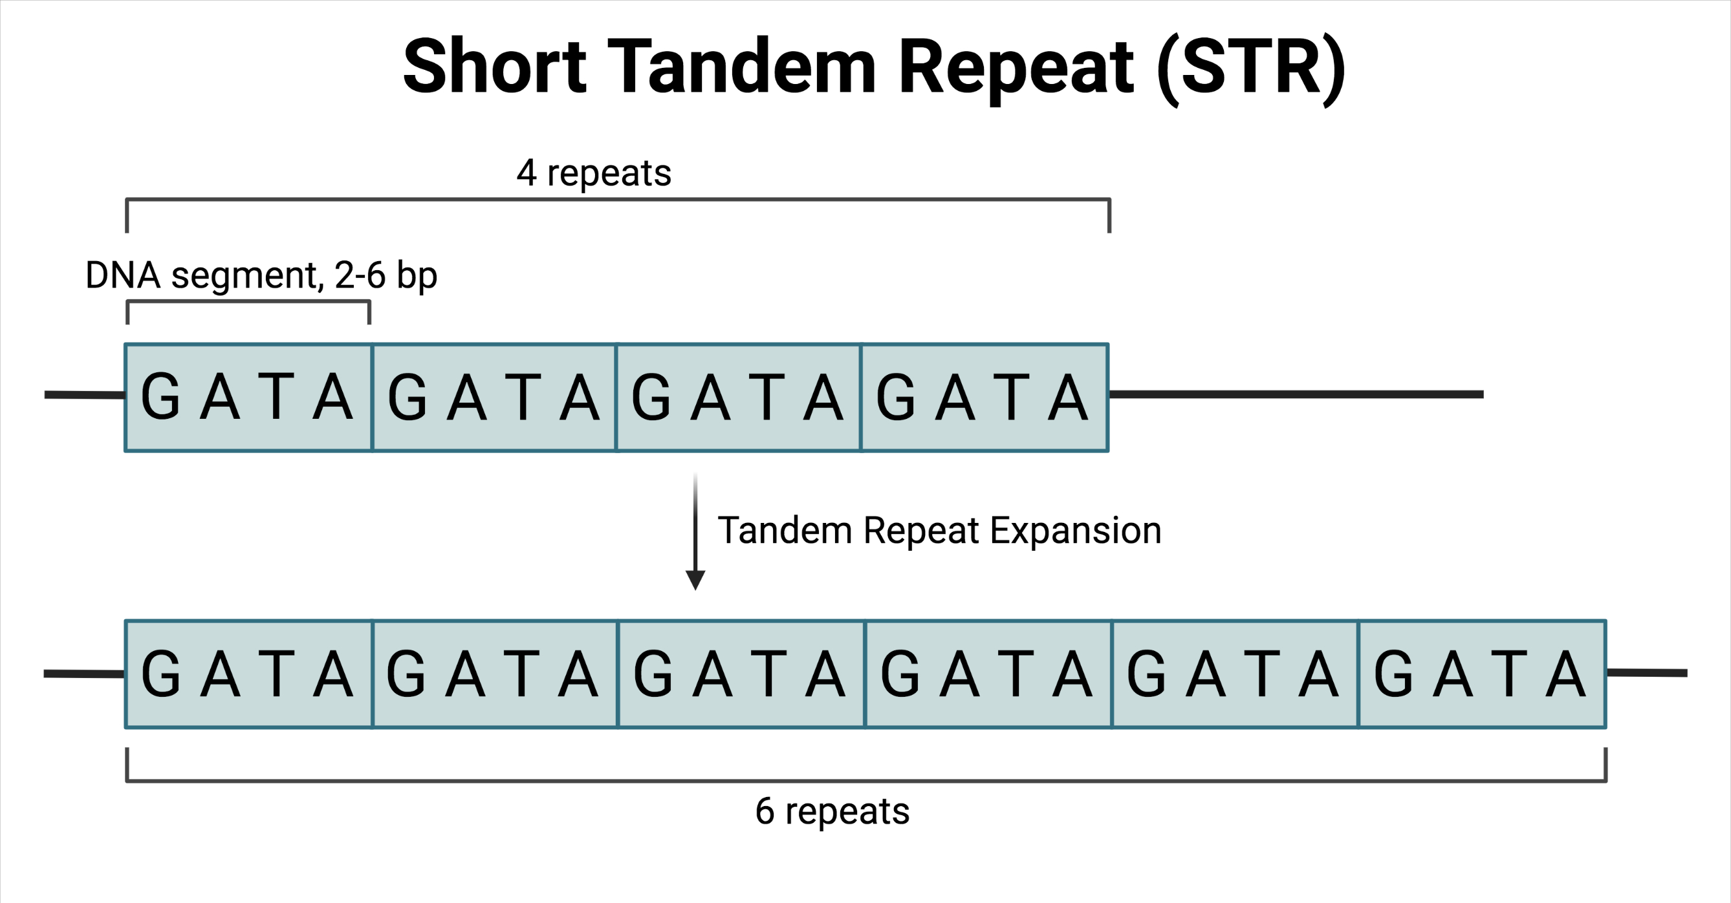
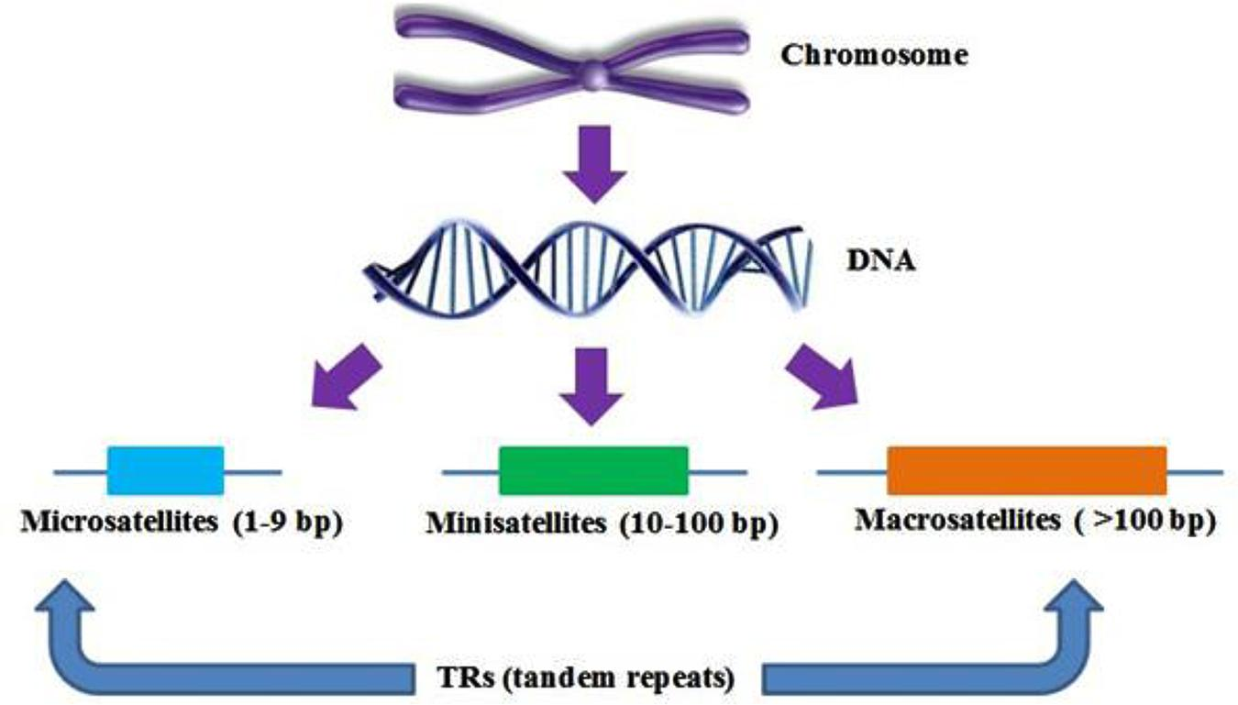
Genomic repetitive DNA con’t
Repetitive DNA is often tandemly repeated. Thus, unequal crossover events can occur relatively frequently. This can lead to large gains of losses of DNA in a short period of time

Slide 17
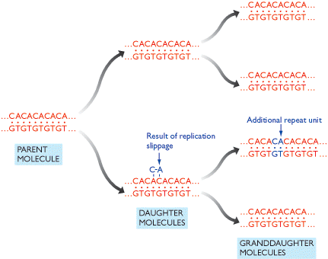
Replication slippage
Caused by a DNA polymerase ‘slipping’ back during DNA replication leading to a duplication of a small region of DNA

Slide 18
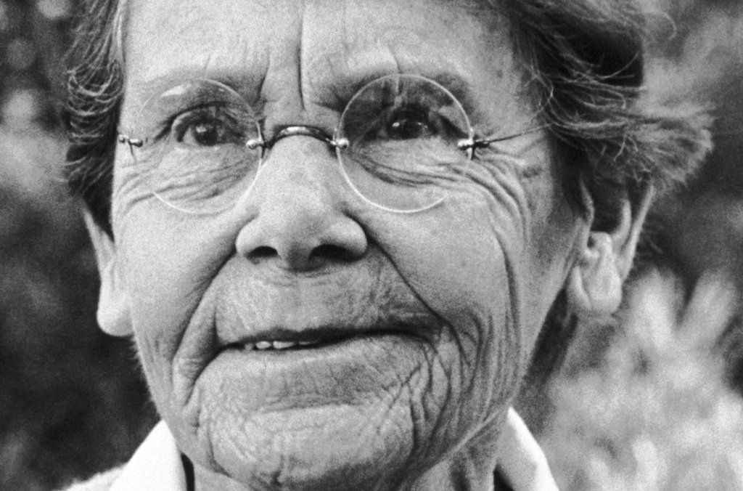
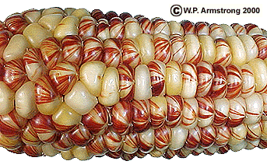
Selfish genetic elements
Collectively comprise a major part of many (especially) eukaryotic genomes, although they are present in bacteria as well. Can move or copy themselves from one location to another in a genome.
First discovered in maize by Barbara McClintock
‘Runaway’ SGE insertion can lead to rapid increases in genome size, often with deleterious effects
Genomes/cells have numerous mechanisms to suppress SGE movement (this is beyond the scope of this module)

Slide 19
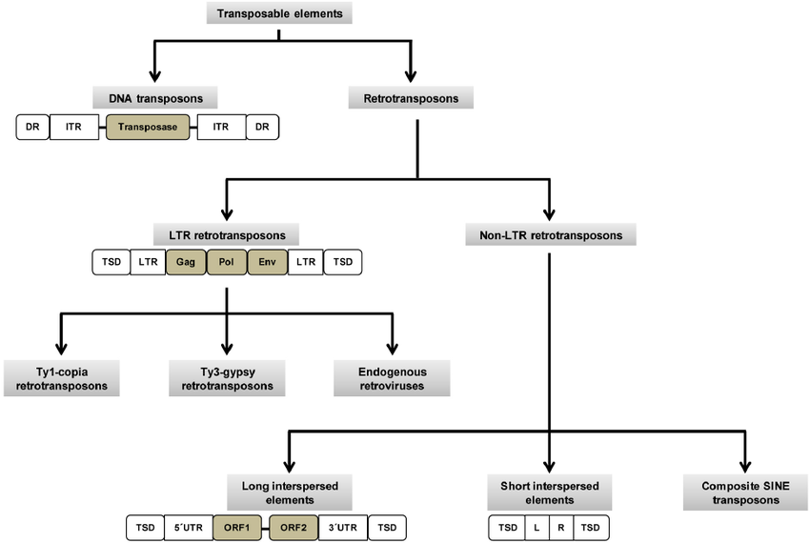
Classification of SGEs
Many types and consist of DNA elements and RNA elements. The RNA elements (often called retroelements or retrotransposons) exist as DNA in the genome (more later)
DNA elements contain a transposase
Retrotransposons contain a reverse transcriptase (RT)
SINEs contain neither but use a RT supplied ‘in trans’
Other SGEs, such as Homing Endonucleases are not discussed here
Notes:
DR=direct repeat. ITR=inverted terminal repeats. These are involved in replication of the element or are a marker of insertion. Not needed for the purposes of this module

Slide 20
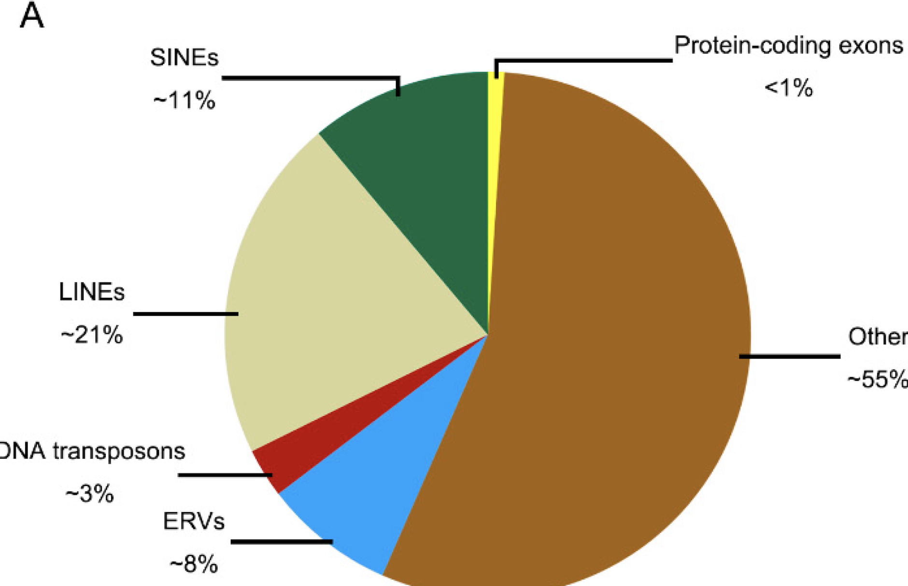
Classification of SGEs (con’t)
In humans and other vertebrate genomes most SGEs are RNA based (SINEs, LINEs, LTR retrotransposons) with only a small proportion of DNA transposons.
Remember RNA based SGEs exist as DNA in the genome!
Endogenous retroviruses (ERVs) (that I work on) are included in the LTR retrotransposons in the left-hand figure. Not sure I agree….

Slide 21
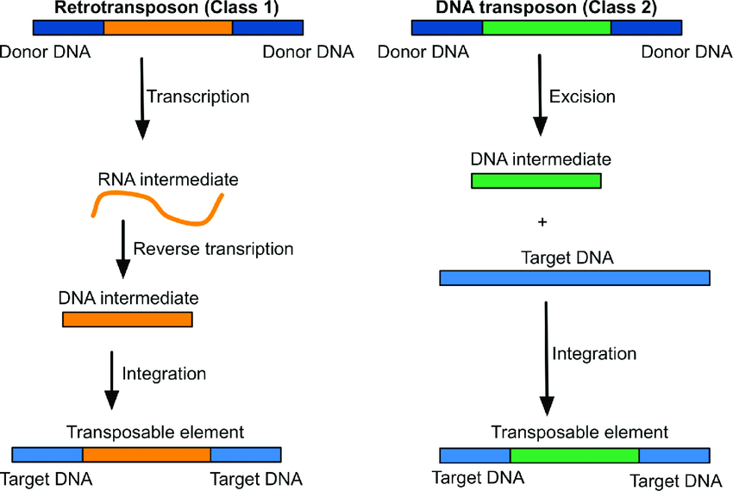
Classification of SGEs (con’t)
Overview of copying/replication mechanism, DNA v RNA elements
Class 1 elements use ‘copy and paste’ whereas class 2 elements use ‘cut and paste’
SINEs are Class 1 but do not encode their own RT. Other Class 1 elements encode their own RT protein. Class 2 elements encode an endonuclease/transposase

Slide 22
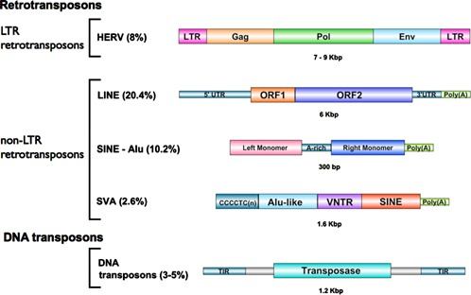
Classification of SGEs (con’t)
These are elements in the human genome with % of genome content shown
I will discuss the important aspects of the figure with you so no need to remember/understand all of it
SINES and SVAs are, in effect tRNA or ribosomal RNA sequences converted to DNA (using LINE ORF 2=RT) and inserted back into the genome
Notes:
“Transposable element classification and molecular structure. LTR-transposons or human endogenous retroviruses (HERVs) are classified in 30–50 distinct families (Gifford and Tristem, 2003) and structurally resemble exogenous retroviruses with two Long Terminal Repeat sequences flanking the coding sequences of the functional polyproteins capsid (gag), protease, polymerase and reverse transcriptase (pol) and envelope (env) that, however, lack the envelope component that is required to exit the cell. Non-LTR-retrotransposons include long interspersed elements (LINEs, present in 20.4% of the human genome), short interspersed elements (SINEs, 10.2%), and SVAs (SINE-R/VNTR/Alu-like, 2.6%). L1 elements require an intact 5′ untranslated region (UTR) that functions as an internal promoter and the production of full-length L1 mRNA that contains functional ORF1 (open reading frame) and ORF2 proteins, encoding for a reverse transcriptase [Moran et al., 1996]. Alus consist of a tRNA-related region that represents the internal promoter stretch, followed by a tRNA unrelated region and a LINE-related region, which is used by the SINE element to bind LINE-encoded proteins to complete LINE-1-mediated retrotransposition (Kajikawa and Okada, 2002). Alus derive their name from the presence of a single recognition site for the restriction enzyme AluI. SINEs are the second most abundant class of mobile elements with more than 1.6 million sites, of which 1.1 million are Alus interspersed in the genome between genes and within the introns. SVAs consist of four domains including a CT-rich repeat at the 5′ end, commonly referred to as CT-hexamer, an Alu-like sequence, so-called for homology with two antisense Alu-like fragments, a GC-variable number tandem repeats (VNTR), whose length determines variation of the full-length SVA elements, a sequence derived from the envelope gene (env) and a SINE-R, an LTR of an extinct HERV-K10 [Hancks et al., 2012]. In the DNA transposons a protein called transposase is bound by terminal inverted repeats (TIRs) that flank the TE, excises the TE out of the donor position and re-integrates it into the genome. In this schematic representation, the genomes of different TEs are not shown to scale.”
https://www.researchgate.net/figure/Transposable-element-classification-and-molecular-structure-LTR-transposons-or-human_fig2_260446945

Slide 23
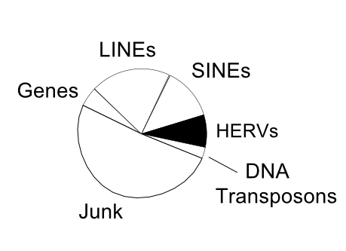
HERVs (as an example of SGE movement and evolution in humans)
HERVs = 5-8%

Slide 24
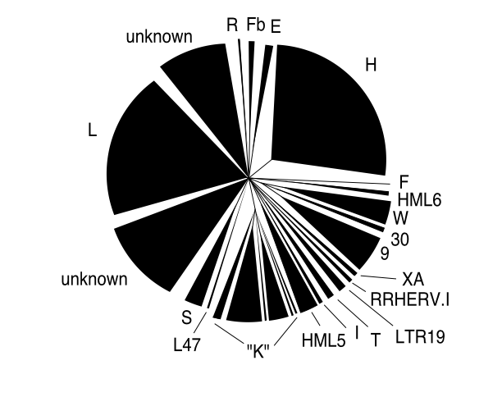
HERV evolution within humans
There are many independently evolving (or have evolved in the past) HERV groups/families within the human genome, some with just a few copies, some with many thousands dispersed throughout the genome
Each group would have originated as a single copy, followed by proliferation within the genome over many millions of years

Slide 25
HERV evolution within humans
Each bifurcation represents a copying event where a new HERV has inserted itself into the genome in a new location
The figure shows that most copying events occurred many millions of years ago and that HERV activity/copying has mostly ceased at the present day
Note the HERV.K-HML2 family
The right-hand side of each phylogeny represents the present day, with the left-hand side representing many millions of years in the past. See key.

Slide 26
HERV evolution within humans
The HERV.K-HML2 family is the only family that has been moving/copying/replicating since humans diverged from chimpanzees
Red=human specific HERVs
Black=viruses present within the genomes of both chimpanzees and humans

Slide 27
HERV evolution within humans
In fact, some HERVs are present within certain individual humans whereas others are not. That is, they display insertional polymorphism.
It is possible that they can cause disease, such as tumours (melanoma, testicular cancer). See next slides
Red=polymorphic viruses/insertions

Slide 28
Impact of SGEs on genomes
As they move around the genome, they are examples of repetitive DNA. Hence, they can promote unequal crossover events
They are insertional mutagens. Thus, they can alter the expression of individual genes, or abolish expression entirely
They can be co-opted, thus benefiting the host genome
ERVs (endogenous retroviruses) can produce viral particles, escape from cells and also cause disease such as leukemia (next slide)
In fact, ERVs cause diseases in many species such as mice and pigs and many others

Slide 29
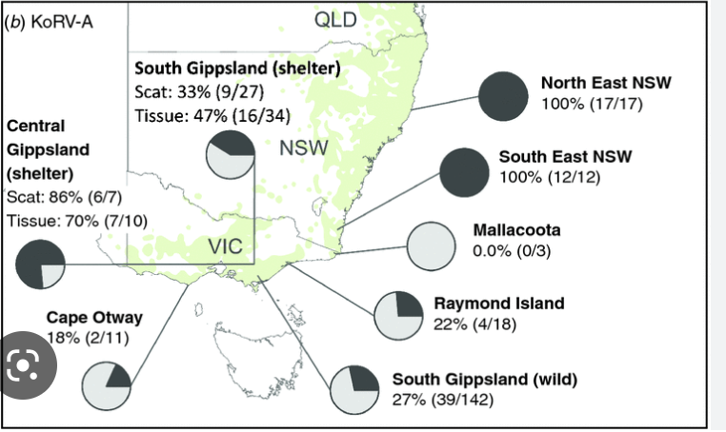
Koala retrovirus
This is one I discovered in 1999 (at least I identified the viral sequence and suggested it caused leukemia in Koalas)
Turns out it is even more interesting as the ERV is only present in certain Koala’s but not others. Hence keeping the populations separate will help conservation efforts
Notes:
https://pubmed.ncbi.nlm.nih.gov/9971829/

